Slide 1

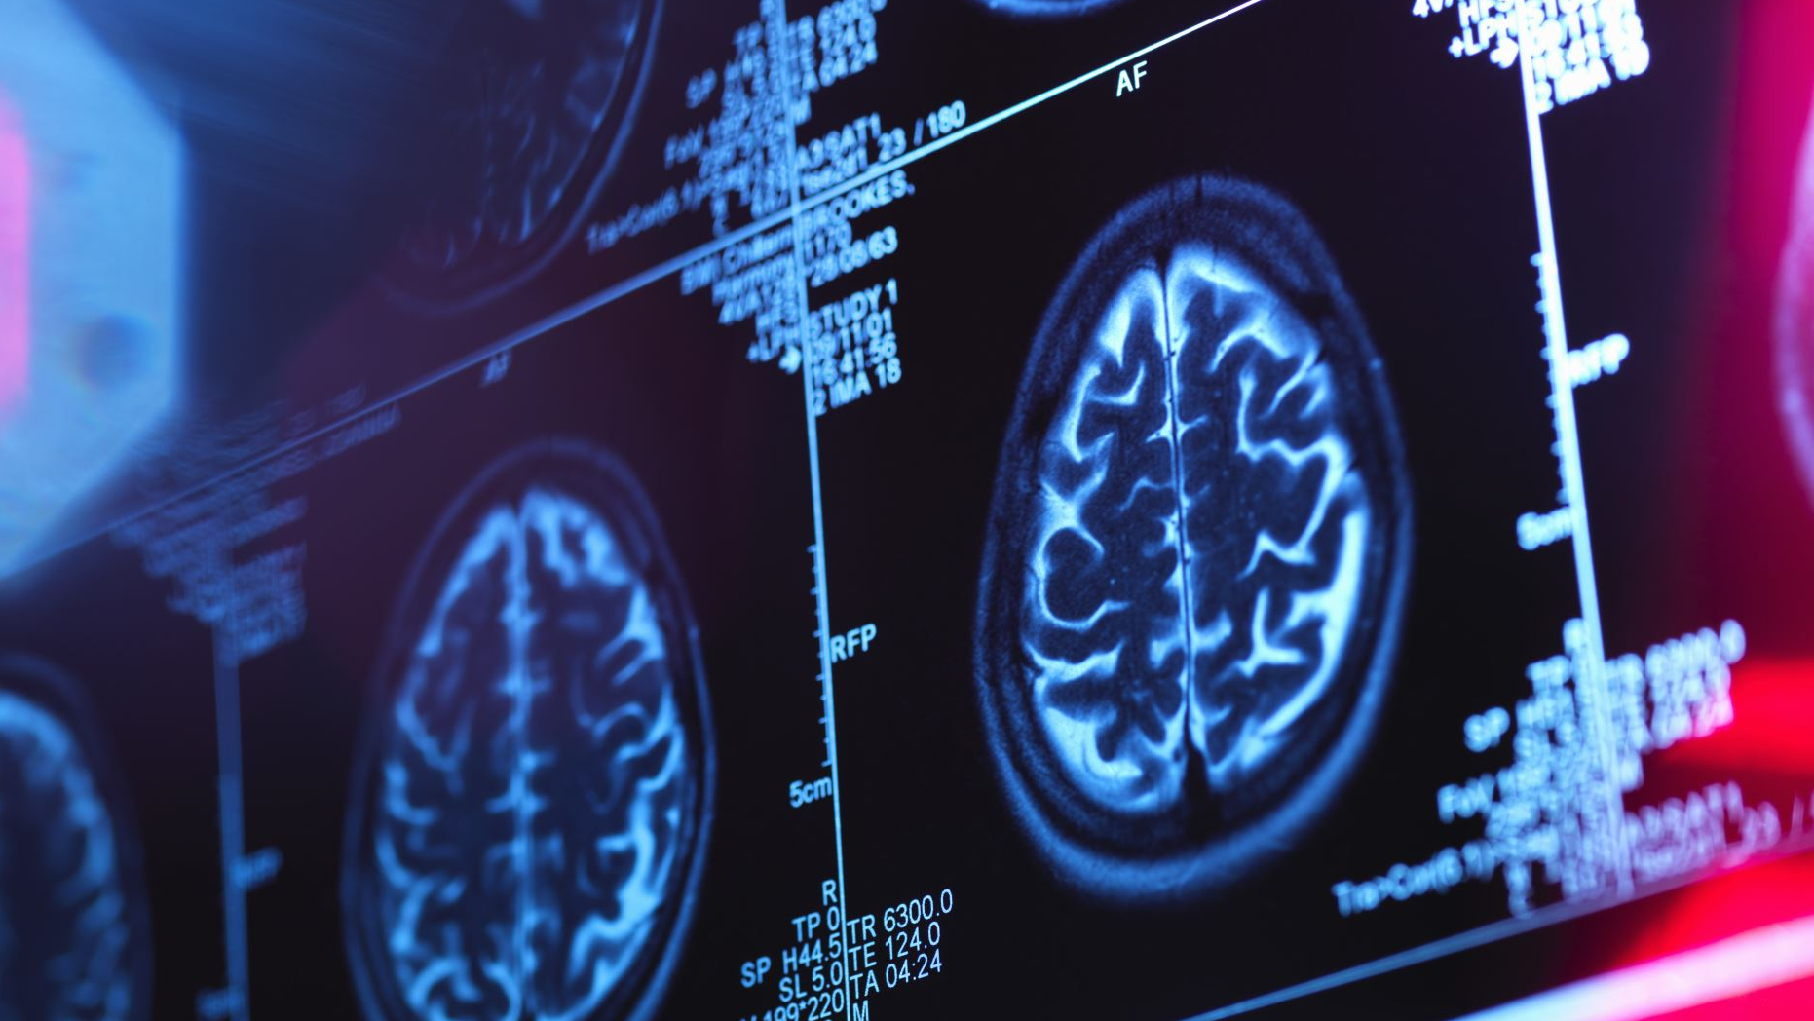
DETECTING IMPERSONATOR IN EXAMINATION HALL USING AI
SRI VAISHNAVI KUMBAR :00438982
SUVARNA SAHU : 00447083
SAI NARENDRA MUGATHA : 00438887

Slide 2
AIM
The main aim of this project is to detect impersonators in examination halls in order to provide a better way of examination handling system which can help in reducing malpractices happening in examination centres.
This system can be very helpful and used as a real time application system.
In proposed system initially images of each student are collected, and each dataset consists of 5-10 images of each student. These images are trained using kdtree algorithm using image processing technique and model is saved in system this model can be used for automatic prediction of student in exam halls from live video or images.

Slide 3
PROBLEM
Also, there can be a scenario, where the student can change the picture on the examination hall ticket to get an admit in the examination center.
As there are various manual testing systems already in place, in which manually the student’s name is mapped to its examination admit card or connect card, but it’s a manual and time taking process.

Slide 4
PURPOSE
The purpose of our project is to find a way to ease the examination process and to bring more advancement and security in this process.
This Project is to build an AI based detector to detect the impersonators who are trying to impersonate the other person in examination halls.

Slide 5
OBJECTIVE
To build a quick and precise student verification process with minimal effort.
To reduce security breaches and impersonators issue with live verification.
To take less time for prediction and processing as the prediction is done automatic using trained model.
In this project we are trying to build an AI System in which images of students can be saved which can be mapped to a different model through transfer learning process to get proper results.

Slide 6
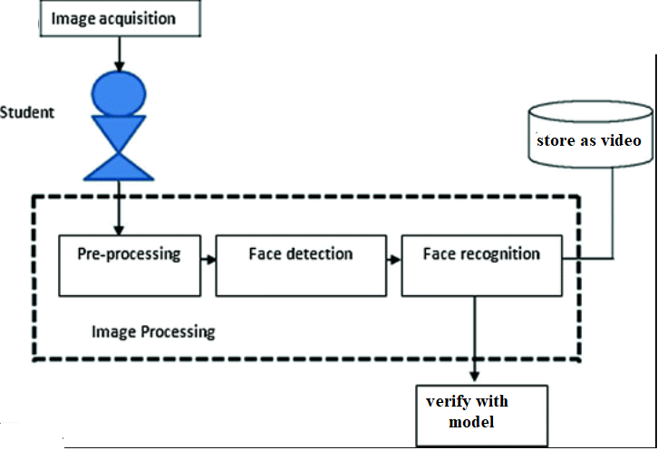
WORKFLOW
Step 1:
The student’s image will be captured
1
Step 2: Processing of the image captured
2
Step 3:
Face Detection as it is unique for all
3
Step 4: Face Recognition based on view or feature
4
Step 5:
Video recording while the detection takes place which will be mapped to the data set stored

Slide 7
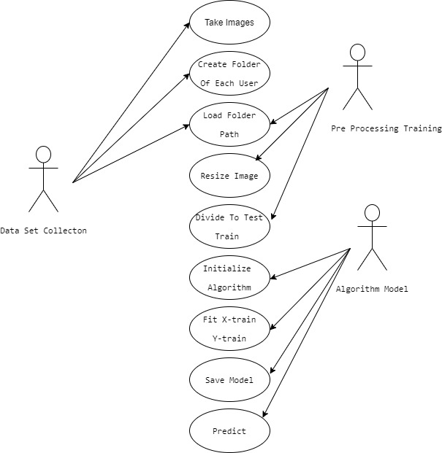
USE CASE DIAGRAM:

Slide 8
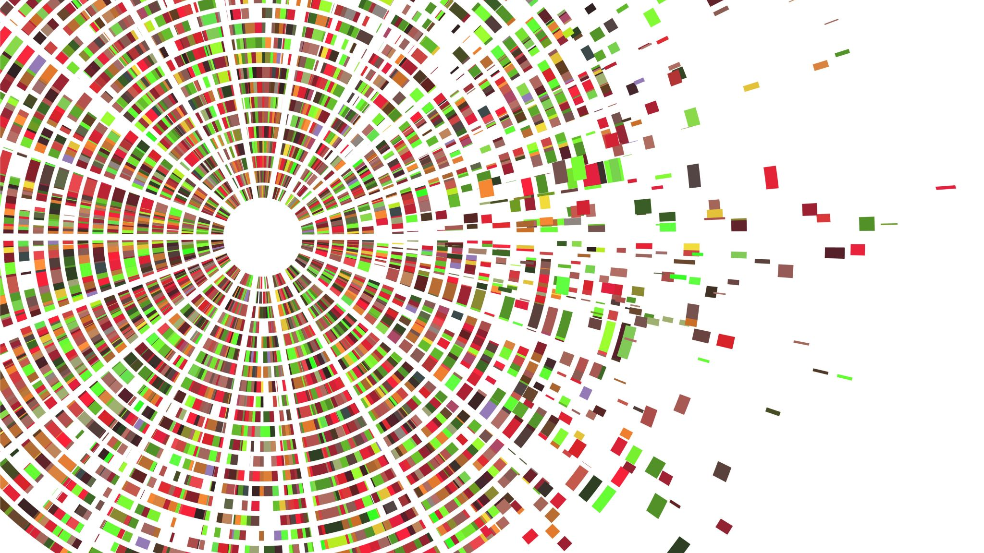
USE CASE DIAGRAM – Cont.…
Data set collection:
Student's data set can be collected manually while issuing connect cards and store in each folder. Minimum 5-10 images need to be collected from each student.
Encoding dataset:
In this stage face recognition, pickle, opencv, sklearn libraries are initialized and each image is looped from the folder using batching and multiprocessing.
Load the input image and convert it from bgr
Detect the (x, y)-coordinates of the bounding boxes
Corresponding to each face in the input image
Compute the facial embedding for the face

Slide 9

Kd- Tree Algorithm
When dealing with a large-scale database, face recognition is time-consuming.
In order to tackle this problem, we employ the k-means clustering algorithm to classify face data.
Specifically, the data in each cluster are stored in the form of the kd-tree, and face feature matching is conducted with the kd-tree based nearest neighborhood search.
Encoded images are given to kd-tree algorithm and model is saved in pickle format.
K-d tree data structure has been used as a data structure for overcoming increased processing times caused by the addition of features into the database. An alternative approach is establishing a balanced k-d tree
Prediction: In this stage input values are taken from image or video and compared with model and results are predicted and output is stored in image or video.
Time Complexity – O(n logn)
Because a d-dimensional kd-tree for a set of n points is a binary tree with n leaves, it uses O(n) storage. The construction time is O(n logn)

Slide 10

STEPS TO IMPLEMENT THE PROJECT
- DEMO
Step-1-Open Anaconda Command Prompt and move to the folder you have stored the python files.
Step-2 conda create -n tf, this command will be used to create a new virtual environment , and pip python=3.6.7 will help us in downloading the module which lends us a way to reliably generate cryptographically strong pseudo-random values. Using these, we can manage secrets like account authentication, tokens, and so.
It will state the packages it will install and ask if we must proceed, press Y
conda create -n tf pip python==3.6.9
Step-3 Now we will activate conda tf, with conda, you can create, export, list, remove, and update environments that have different versions of Python and/or packages installed in them. Switching or moving between environments is called activating the environment.
conda activate tf

Slide 11
Step-4 Now we are in tf (tensorflow) environment, we need to install the libraries and packages of python namely dlib, imutils, NumPy, open cv2, scikit-learn and face-recognition.
Dlib is used to estimate the location of coordinates that map the facial points on a person’s face.
Imutils is a series of convenience functions to make basic image processing functions such as translation, rotation, resizing, skeletonization, displaying Matplotlib images, sorting contours, detecting edges.
NumPy is used to perform a wide variety of mathematical operations on arrays.
OpenCV is a Python library that allows you to perform image processing and computer vision tasks
The sklearn library contains a lot of efficient tools for machine learning and statistical modeling including classification, regression, clustering, and dimensionality reduction.
Facial recognition is a way of identifying or confirming an individual's identity using their face. Facial recognition systems can be used to identify people in photos, videos, or in real-time.
conda install -c conda-forge dlib​
pip install imutils​
pip install opencv-contrib-python​
conda install -c conda-forge face_recognition​
pip install scikit-learn==0.22.1​

Slide 12
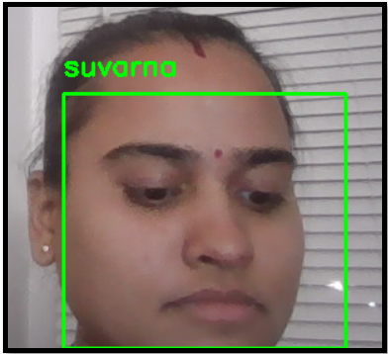
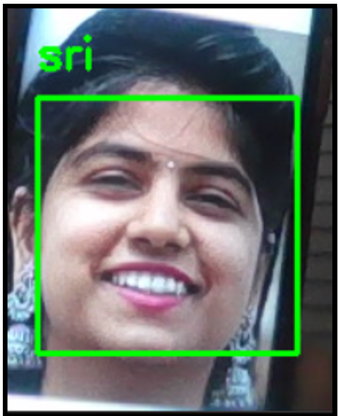
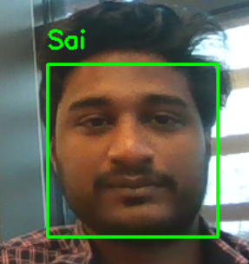
Step-5- As all the packages and libraries are installed, now we will be training the model we are using, the hog model.
This is based on the HOG (Histogram of Oriented Gradients) feature descriptor with a linear SVM machine learning algorithm to perform face detection.
HOG is a simple and powerful feature descriptor. It is not only used for face detection but also it is widely used for object detection like cars, pets, and fruits. HOG is robust for object detection because object shape is characterized using the local intensity gradient distribution and edge direction.
python faceEncode.py --dataset dataset/dataset --encodings encodings.pickle -d hog
Step-6- Now we will start the video stream.
python faceRecVideo.py -e encodings.pickle -o output_vids/ex1.avi -y 0 -d hog
Output screens.

Slide 13
ADVANTAGES
With this model, there will be no security breaches.
The verification process will be quick and easy.
Faster and more convenient compared to other biometric technologies like fingerprint.
As it uses a trained model, the process is quick.
We can identify the impersonators.
Drastically reduces human touchpoints.
FUTURE WORK
We can make this system as attendance face recognition system where we will use a webcam to record the attendance live in an excel sheet.

Slide 14
REFERENCES
T.-H. Kim, D.-C. Park, D.-M. Woo, T. Jeong, and S.-Y. Min, “Multi-class classifierbased adaboost algorithm,” in Proceedings of the Second Sinoforeign-interchange Conference on Intelligent Science and Intelligent Data Engineering, ser. IScIDE’11. Berlin, Heidelberg: Springer-Verlag, 2012, pp. 122– 127.
P. Viola and M. J. Jones, “Robust real-time face detection,” Int. J. Comput. Vision, vol. 57, no. 2, pp. 137–154, May 2004.
P. Viola and M. Jones, “Rapid object detection using a boosted cascade of simple features,” in Proceedings of the 2001 IEEE Computer Society Conference on Computer Vision and Pattern Recognition. CVPR 2001, vol. 1, Dec 2001, pp. I–I.
J. Li, J. Zhao, Y. Wei, C. Lang, Y. Li, and J. Feng, “Towards real world human parsing: Multiple-human parsing in the wild,” CoRR, vol. abs/1705.07206.
J. Li, J. Zhao, Y. Wei, C. Lang, Y. Li, and J. Feng, “Towards real world human parsing: Multiple-human parsing in the wild,” CoRR, vol. abs/1705.07206.
https://aws.amazon.com/what-is/facial-recognition/#:~:text=It%20is%20faster%20and%20more,authentication%20for%20additional%20security%20verification

Slide 15

Questions

Slide 16

Thank You

